Slide 1


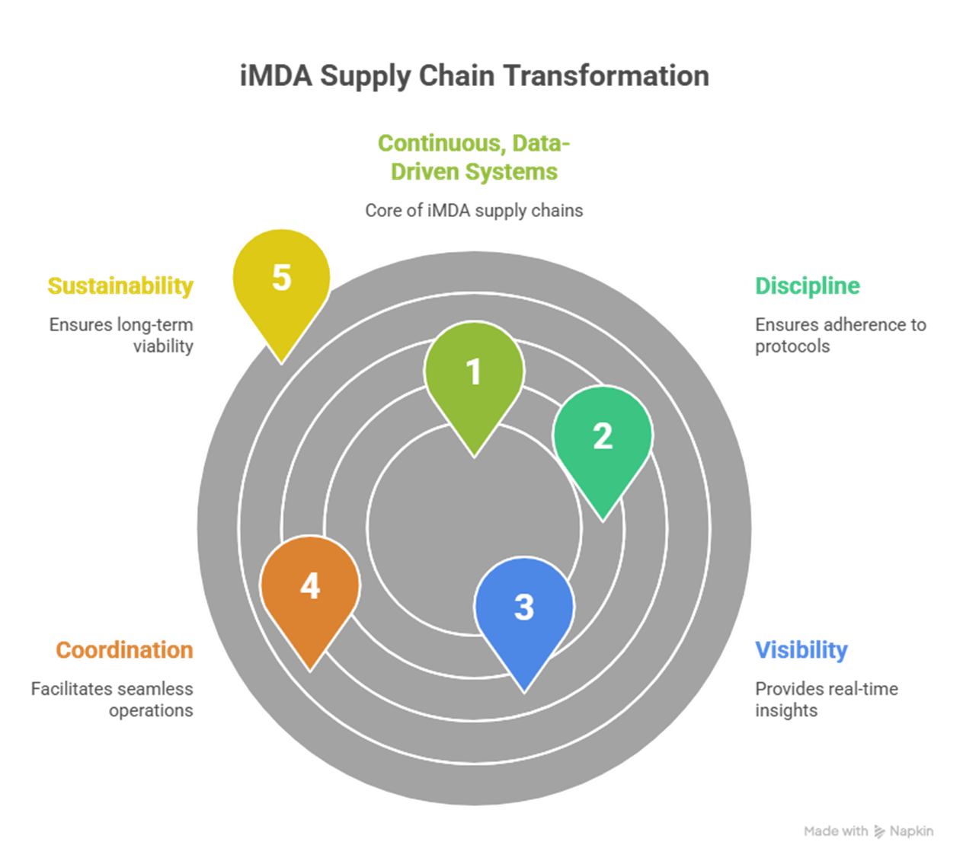
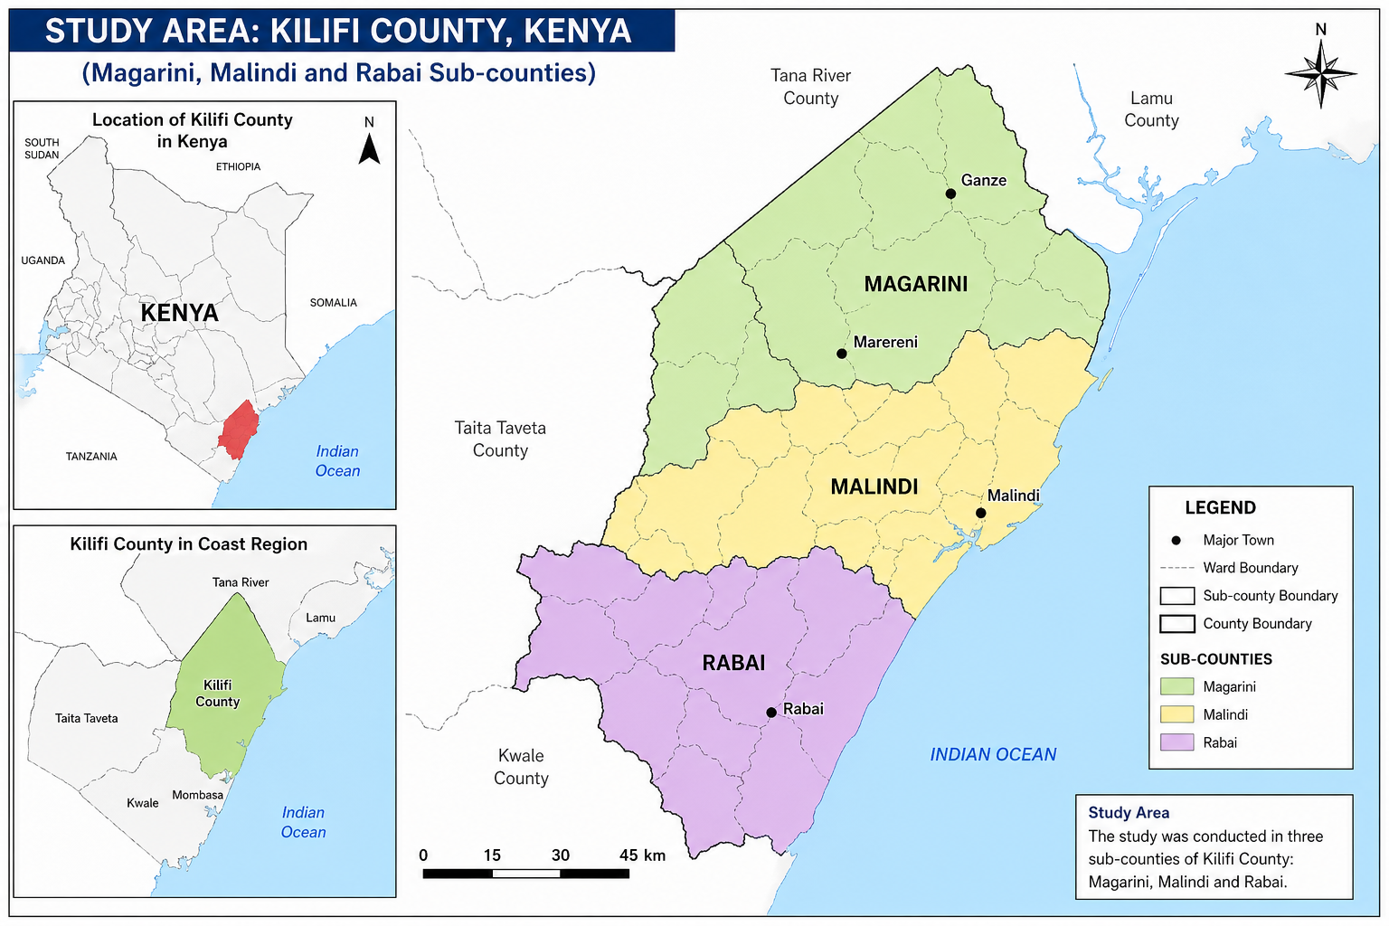

Integrated Mass Drug Administration Versus Campaign Delivery in Kilifi County, Kenya: Supply Chain Performance Comparison
Getrude Nasike¹, Wycliffe Omondi², Willie Njoroge², Titus Watitu², Lenson Kariuki², Vicent Manyilizu¹, Mark Osiemo¹, Yasmin Chandani¹
1. In-Supply Health 2. Kenya National Public Health Institute.
BACKGROUND
Mass Drug Administration (MDA) is central to controlling schistosomiasis (SCH) and soil-transmitted helminthiases (STH). Its success depends on supply chain discipline; forecasting, distribution, inventory control, and reporting.
In 2025, Kilifi County piloted Integrated MDA (iMDA), embedding drug delivery within routine community systems using eCHIS. This study compares iMDA with campaign-based MDA.
OBJECTIVES
Determine ward-level prevalence of schistosomiasis
Assess spatial heterogeneity.
Generate evidence to guide stratification interventions and mass drug administration (MDA) planning.
METHODOLOGY: MIXED-METHODS COMPARATIVE STUDY.
STUDY AREA: Kilifi County (Magarini, Malindi, Rabai sub-counties),fi
Mixed-methods comparative study
Indicators: quantification, distribution, redistribution, visibility, reporting, reverse logistics
Data: JRSM, S-11, eCHIS, NTD-IDB
KIIs across national, county, and community levels
RESULTS
The integrated Mass Drug Administration (iMDA) model demonstrated improved supply chain performance compared to the campaign-based approach. Registry-based household data enhanced quantification accuracy and reduced mismatches between supply and demand. In contrast, campaign MDA was characterized by compressed timelines, high prepositioning pressure, and redistribution rates approximately three times higher. The iMDA approach enabled more continuous and structured distribution, improving last-mile efficiency. Digital reporting through the electronic Community Health Information System (eCHIS) strengthened real-time inventory visibility, supervision, and data reconciliation, addressing delays associated with paper-based reporting in campaign delivery. Additionally, iMDA supported domestic resource mobilization through county co-financing of Albendazole, reaching over 500,000 individuals. However, reverse logistics remained weak in both models, although digital tracking under iMDA improved discrepancy detection and accountability.
DISCUSSION
The findings demonstrate that integrating MDA into routine service delivery strengthens supply chain discipline by shifting from episodic, high-pressure campaigns to continuous, data-driven operations. Improved quantification under iMDA highlights the value of registry-based planning in enhancing allocation efficiency and reducing uncertainty. The reduction in redistribution and improved last-mile delivery reflect stronger alignment between supply and community needs. Digital integration through eCHIS plays a critical role in enhancing visibility, accountability, and decision-making across the supply chain. However, persistent weaknesses in reverse logistics indicate the need for deliberate investment to achieve full end-to-end system performance. The increased role of county financing further signals a transition toward domestic ownership, which is essential for long-term sustainability.
CONCLUSIONS
The transition from campaign-based MDA to iMDA fundamentally transforms NTD supply chain systems by embedding them within routine, data-driven service delivery platforms. This shift enhances quantification accuracy, improves distribution efficiency, strengthens inventory visibility, and promotes accountability across all levels of implementation. By fostering supply chain discipline and increasing domestic ownership, iMDA offers a sustainable pathway for optimizing resource use and maintaining high treatment coverage. However, to fully realize these gains, targeted investments in reverse logistics, last-mile supervision, and integrated digital systems will be essential.
Contact: getrude_nasike@insupplyhealth.com

